Slide 1
Processes and Threads
Manish Shrivastava

Slide 2
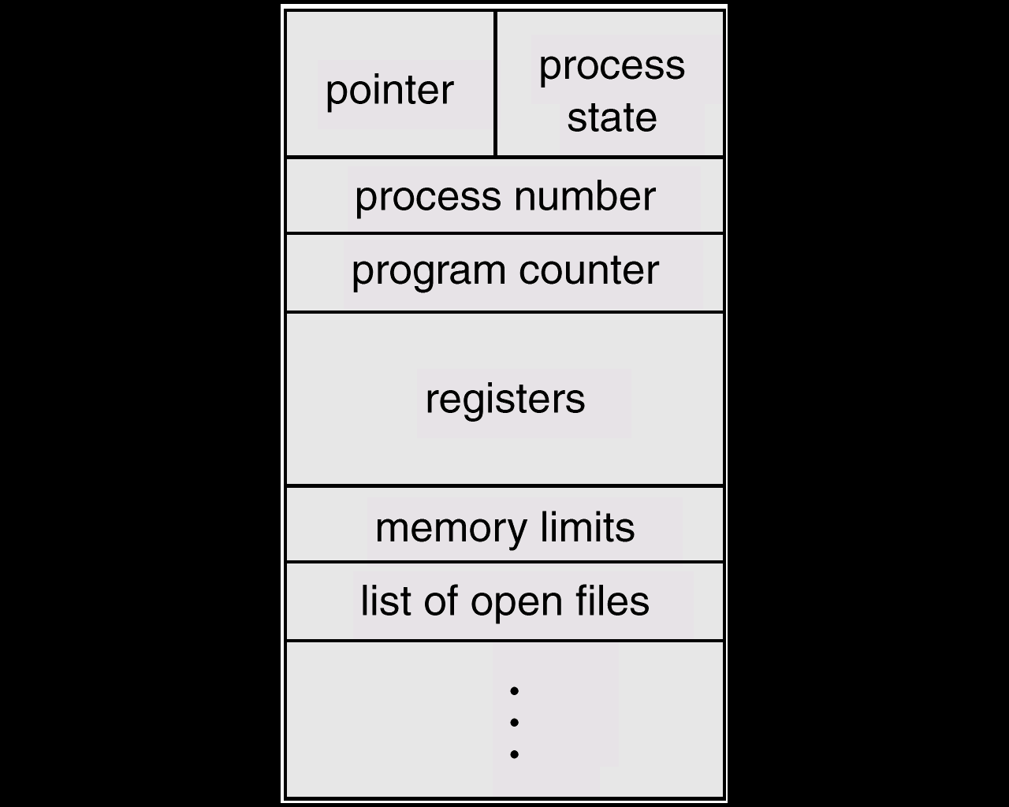
Process Control Block (PCB)

Slide 3
Process Control Block (PCB)
Information associated with each process.
Process state: new, ready, running,…
Program Counter (PC): address of the next instruction to execute
CPU registers: data registers, stacks, condition-code information, etc.
CPU scheduling information: process priorities, pointers to scheduling queues, etc.

Slide 4
Process Control Block (PCB)
Memory-management information: locations including value of base and limit registers, page tables and other virtual memory information.
Accounting information: the amount of CPU and real time used, time limits, account numbers, job or process numbers etc.
I/O status information: List of I/O devices allocated to this process, a list of open files, and so on

Slide 5
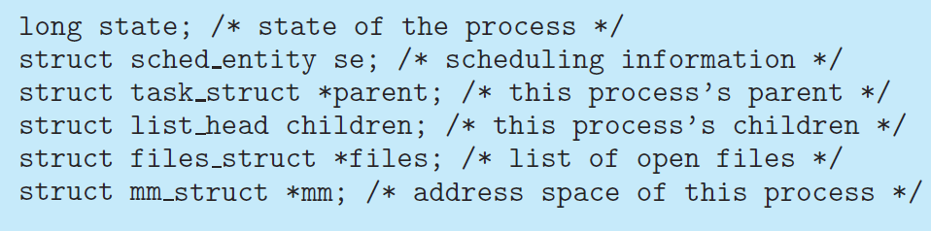
Process Control Block (PCB)
The process control block in the Linux operating system is represented by the C structure task struct, which is found in the <linux/sched.h> include file in the kernel source-code directory.

Slide 6
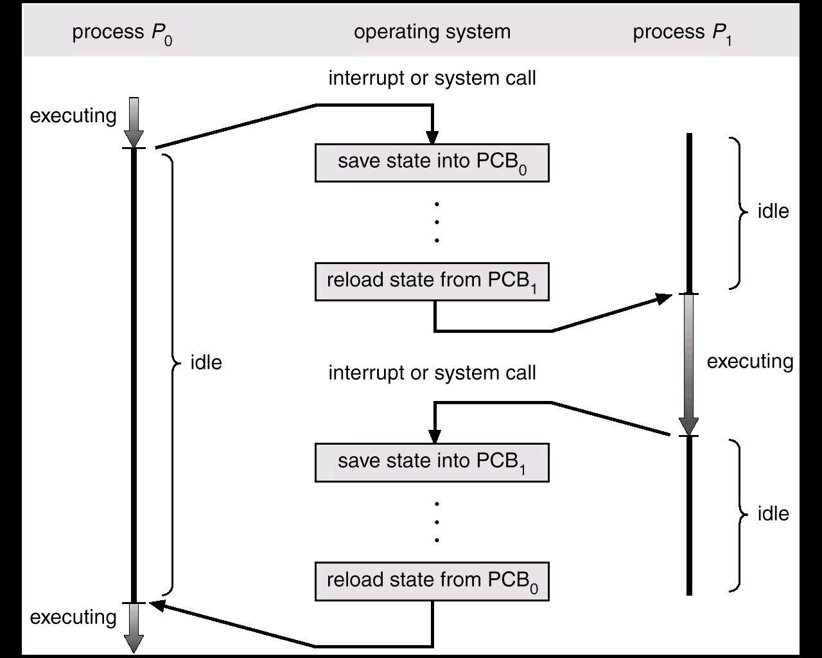
CPU Switch From Process to Process

Slide 7
Process Scheduling Queues
Scheduling is to decide which process to execute and when
The objective of multi-program
To have some process running at all times.
Timesharing: Switch the CPU frequently that users can interact can interact with the program while it is running.
If there are many processes, scheduling is used to decide which process to execute and when.
Scheduling queues:
Job queue – set of all processes in the system.
Ready queue – set of all processes residing in main memory, ready and waiting to execute.
Device queues – set of processes waiting for an I/O device.
Each device has its own queue.
Process migrates between the various queues during its life time.

Slide 8
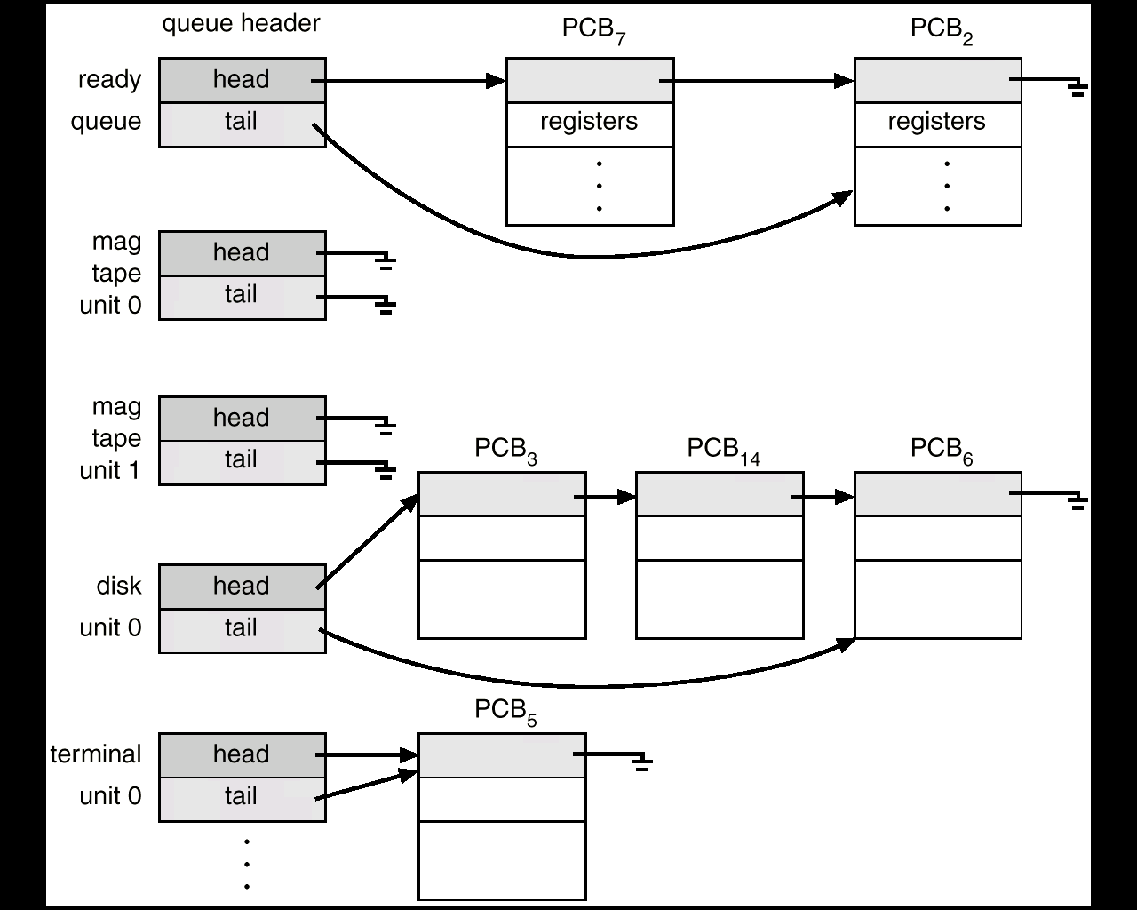
Ready Queue And Various I/O Device Queues

Slide 9
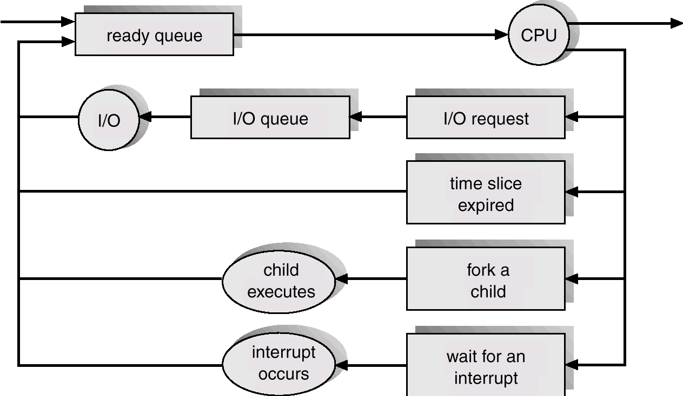
Representation of Process Scheduling
Queuing Diagram

Slide 10
Representation of Process Scheduling
A new process is initially put in the ready queue
Once a process is allocated CPU, the following events may occur
A process could issue an I/O request
A process could create a new process
The process could be removed forcibly from CPU, as a result of an interrupt.
When process terminates, it is removed from all queues. PCB and its other resources are de-allocated.

Slide 11
Process Schedulers
A process migrates between the various scheduling queues throughout its lifetime.
The OS must select a process from the different process queues in some fashion. The selection process is carried out by a scheduler.
In a batch system the processes are spooled to mass-storage device.
Long-term (LT) scheduler (or job scheduler) – selects which processes should be brought into the ready queue.
The LT scheduler controls degree of multiprogramming (i.e., the number of processes active in the system)
DoM is stable: average rate of process creation == average departure rate of processes.

Slide 12
Process Schedulers
The LT scheduler should make a careful selection.
Most processes are either I/O bound or CPU bound.
I/O bound process spends more time doing I/O than it spends doing computation.
CPU bound process spends most of the time doing computation.
The LT scheduler should select a good mix of I/O-bound and CPU-bound processes.
Example:
If all the processes are I/O bound, the ready queue will be empty
If all the processes are CPU bound, the I/O queue will be empty, the devices will go unutilized and the system will be imbalanced.

Slide 13
Process Schedulers
Short-term (ST) scheduler
selects which process should be executed next and allocates CPU.
It is executed at least once every 100 ms.
If 10 ms is used for selection, then 9 % of CPU is used (or wasted)
The long-term scheduler executes less frequently.

Slide 14
Process Schedulers
Some OSs introduced a Medium-Term scheduler using swapping.
Advantageous to remove the processes from the memory and reduce the multiprogramming.
Swapping: removal of process from main memory to disk to improve the performance. At some later time, the process can be reintroduced into main memory and its execution can be continued when it left off.
Swapping improves the process mix (I/O and CPU), when main memory is unavailable.

Slide 15
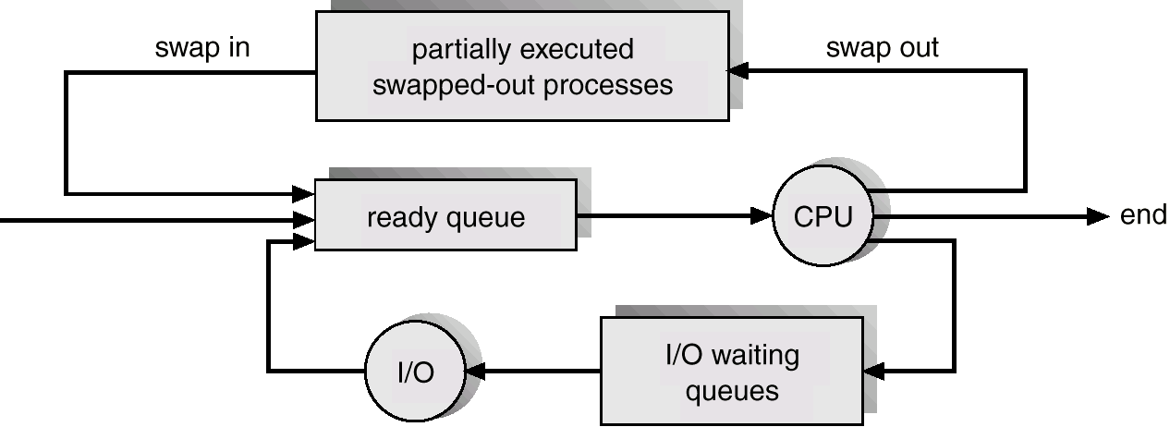
Addition of Medium Term Scheduling

Slide 16
Context Switch
Context switch is a task of switching the CPU to another process by saving the state of old process and loading the saved state for the new process
Context of old process is saved in PCB and loads the saved context of old process.
Context-switch time is overhead; the system does no useful work while switching.
New structures threads were incorporated.
Time dependent on hardware support.
1 to 1000 microseconds

Slide 17
Operations on Processes
Process Creation
Process Termination

Slide 18
Process Creation
A system call is used to create process.
Assigns unique id
Space
PCB is initialized.
The creating process is called parent process.
Parent process creates children processes, which, in turn create other processes, forming a tree of processes.
In UNIX pagedaemon, swapper, and init children are root process. Users are children of init process.
A process needs certain resources to accomplish its task.
CPU time, memory, files, I/O devices.

Slide 19
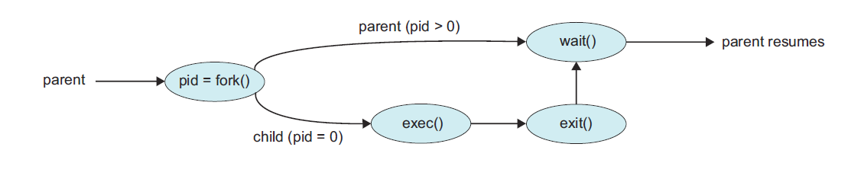
Process Creation
When a process creates a new process,
Resource sharing possibilities.
Parent and children share all resources.
Children share subset of parent’s resources.
Parent and child share no resources.
Execution possibilities
Parent and children execute concurrently.
Parent waits until children terminate.
Address space
Child duplicate of parent.
Child has a program loaded into it.

Slide 20
Process Creation
UNIX examples
fork system call creates new process
exec system call used after a fork to replace the process’ memory space with a new program.
The new process is a copy of the original process.
The exec system call is used after a fork by one of the two processes to replace the process memory space with a new program.
WINDOWS NT supports both models:
Parent address space can be duplicated or
parent can specify the name of a program for the OS to load into the address space of the new process.

Slide 21
UNIX: fork() system call
fork() is used to create processes. It takes no arguments and returns a process ID.
fork() creates a new process which becomes the child process of the caller.
After a new process is created, both processes will execute the next instruction following the fork() system call.
The checking the return value, we have to distinguish the parent from the child.
fork()
If returns a negative value, the creation is unsuccessful.
Returns 0 to the newly created child process.
Returns positive value to the parent.
Process ID is of type pit_t defined in sys/types.h
getpid() can be used to retrieve the process ID.
The new process consists of a copy of address space of the original process.

Slide 22
UNIX: fork() system call
#include <stdio.h>
#include <string.h>
#include <sys/types.h>
#define MAX_COUNT 200
#define BUF_SIZE 100
void main(void)
{
pid_t pid;
int i;
char buf[BUF_SIZE];
fork();
pid=getpid();
for(i=1; i<=MAX_COUNT;i++)
{
sprintf(buf,”This line is from pid %d, value=%d\n”,pid,i);
write(1,buf,strlen(buf));
}
}

Slide 23
UNIX: fork() system call
If the fork() is executed successfully, Unix will
Make two identical copies of address spaces; one for the parent and one for the child.
Both processes start their execution at the next statement after the fork().
Parent
Child
main()
{
fork();
pid=…;
}
main()
{
fork();
pid=…
}

Slide 24
UNIX: fork() system call
#include <stdio.h>
#include <sys/types.h>
#define MAX_COUNT 200
void ChildProcess(void);
void ParentProcess(void);
#define BUF_SIZE 100
void main(void)
{
pid_t pid;
pid=fork();
if (pid==0)
ChildProcess();
else
ParentProcess();
}
}
Void ChildProcess(void)
{
int i;
for(i=1;i<=MAX_COUNT;i++)
{
printf(buf,”This line is from child, value=%d\n”,i);
Printf(“ *** Child Process is done ***\n”);
}
}
Void ParentProcess(void)
{
int i;
for(i=1;i<=MAX_COUNT;i++)
{
printf(buf,”This line is from parent, value=%d\n”,i);
printf(“ *** Parent Process is done ***\n”);
}
}

Slide 25
UNIX: fork() system call
Parent
Child
PID=3456
void main(void)
{
pid=fork();
if (pid==0)
ChildProcess();
else
ParentProcess();
}
}
Void ChildProcess(void)
{
}
Void ParentProcess(void)
{
}
void main(void)
{
pid=fork();
if (pid==0)
ChildProcess();
else
ParentProcess();
}
}
Void ChildProcess(void)
{
}
Void ParentProcess(void)
{
}
PID=0

Slide 26
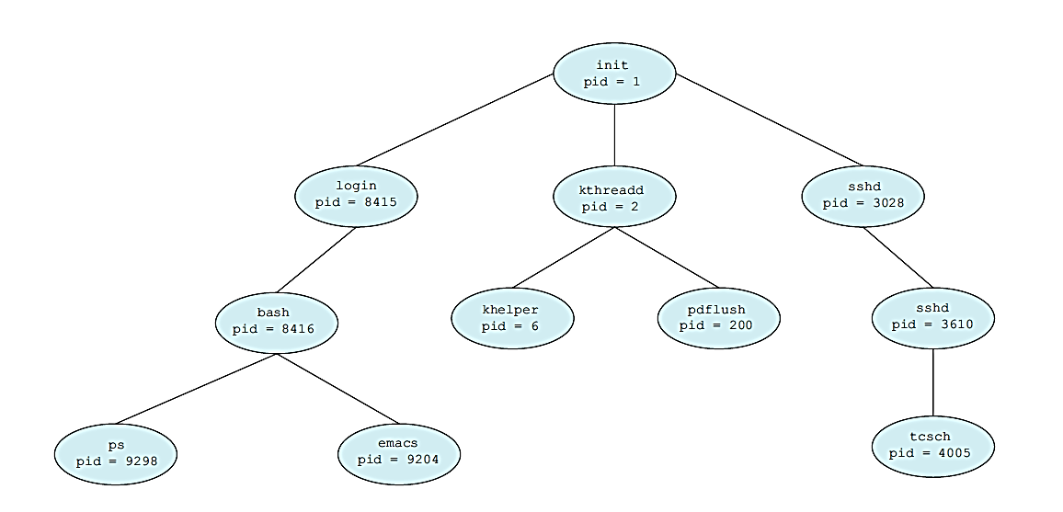
Processes Tree on a UNIX System

Slide 27
UNIX system initialization
bootstrap
process 0
Swapper
Wait until init exits SYSTEM SHUTDOWN
fork
process 1
Wait until all children exit
init
fork
exec
exec
getty
login
shell
fork
User
commands
.
.
.
As many as available
exit

Slide 28
Process Termination
Process executes last statement and asks the operating system to decide it (exit).
Output data from child to parent (via wait).
Process’ resources are deallocated by operating system.
Parent may terminate the execution of children processes (abort).
Child has exceeded allocated resources.
Task assigned to child is no longer required.
Parent is exiting.
Many operating system does not allow child to continue if its parent terminates leading to phenomenon of Cascading termination.

Slide 29
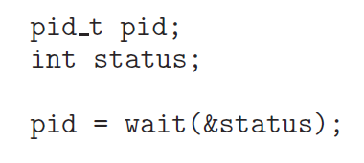
Process Termination
A process that has terminated, but whose parent has not yet called wait(), is known as a zombie process.
When a process terminates, its resources are deallocated by the operating system. However, its entry in the process table must remain there until the parent calls wait(), because the process table contains the process’s exit status.
If a parent did not invoke wait() and instead terminated, thereby leaving its child processes as orphans.
UNIX address this scenario by assigning the init process as the new parent to orphan processes.

Slide 30
Cooperating Processes
The processes can be independent or cooperating processes.
Independent process cannot affect or be affected by the execution of another process.
Cooperating process can affect or be affected by the execution of another process
Advantages of process cooperation
Information sharing
Computation speed-up: Break into several subtasks and run in parallel
Modularity: Constructing the system in modular fashion.
Convenience: User will have many tasks to work in parallel
Editing, compiling, printing

Slide 31
Definition
Process: group resources together
Thread: entity scheduled for execution in a process
“Single sequential stream of instructions within a process”
“Lightweight process”

Slide 32
Thread of Execution

Slide 33
Thread vs. Process
Threads have their own:
Thread ID (TID) (compare to PID)
Program counter (PC)
Register set
Stack
Threads commonly share:
Code section (text)
Data section
Resources (files, signals, etc.)

Slide 34
Why Threads?
Enable multi-tasking within an app
Update display
Fetch data
Spell checking
Answer a network request
Reduced cost (“lightweight” process)
Processes are heavy to create
IPC for threads cheaper/easier than processes
Can “simplify” code & increase efficiency
Kernels are generally multithreaded (different threads provide different OS services)

Slide 35
Multi-Threaded Server
(thread pool)

Slide 36
Benefits
Responsiveness – may allow continued execution if part of process is blocked, especially important for user interfaces
Resource Sharing – threads share resources of process, easier than shared memory or message passing
Economy – cheaper than process creation, thread switching lower overhead than context switching
Scalability – process can take advantage of multiprocessor architectures

Slide 37
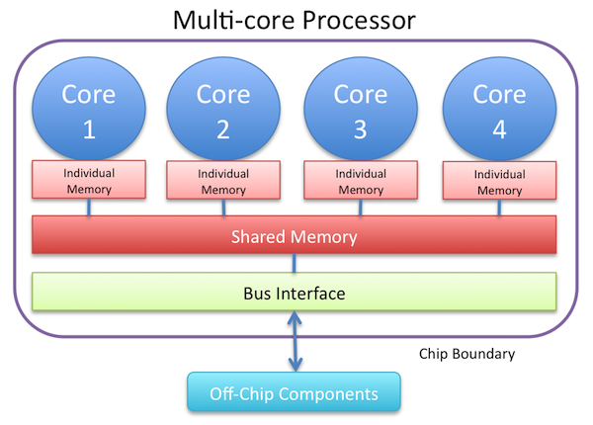
Multicore Systems

Slide 38
Multicore Programming
Multicore systems putting pressure on programmers; challenges include:
Dividing activities (which tasks to parallelize)
Balance (if/how to parallelize tasks)
Data splitting (how to divide data)
Data dependency (thread synchronization)
Testing and debugging (how to test different execution paths)
Parallelism implies a system can perform more than one task simultaneously
Concurrency supports more than one task making progress
Single processor/core, scheduler providing concurrency

Slide 39
Concurrency vs. Parallelism
Concurrent execution on single-core system
Parallelism on a multi-core system

Slide 40
Multicore Programming
Types of parallelism
Data parallelism – distributes subsets of the same data across multiple cores, same operation on each
Task parallelism – distributing threads across cores, each thread performing unique operation
As # of threads grows, so does architectural support for threading (“hyperthreading”)
CPUs have cores as well as hardware threads
Consider Oracle SPARC T4 with 8 cores and 8 hardware threads per core

Slide 41

Data vs. Task Parallelism
Count number of times each character in alphabet occurs
Data Parallelism
Thread 1 does page 1-100
Thread 2 does page 100-200
Task Parallelism
Thread 1 does letters A-F, all pages
Thread 2 does letters G-L, all pages

Slide 42
Single and Multithreaded Processes

Slide 43
User Threads and Kernel Threads
User threads - management done by user-level threads library
Three primary thread libraries:
POSIX Pthreads
Win32 threads
Java threads
Kernel threads - Supported by the Kernel, “schedulable entity”
Examples – virtually all general purpose operating systems, including:
Windows
Solaris
Linux
Tru64 UNIX
Mac OS X

Slide 44
Multithreading Models
Many-to-One
One-to-One
Many-to-Many

Slide 45
Many-to-One
Many user-level threads mapped to single kernel thread
One thread blocking causes all to block
Multiple threads may not run in parallel on multicore system because only one may be in kernel at a time
Few systems currently use this model
Examples:
Solaris Green Threads
GNU Portable Threads

Slide 46
One-to-One
Each user-level thread maps to kernel thread
Creating a user-level thread creates a kernel thread
More concurrency than many-to-one
Number of threads per process sometimes restricted due to overhead
Examples
Windows NT/XP/2000
Linux
Solaris 9 and later

Slide 47
Many-to-Many Model
Allows many user level threads to be mapped to many kernel threads
Allows the operating system to create a sufficient number of kernel threads
Solaris prior to version 9
Windows NT/2000 with the ThreadFiber package

Slide 48
Two-level Model
Similar to M:M, except that it allows a user thread to be bound to kernel thread
Examples
IRIX
HP-UX
Tru64 UNIX
Solaris 8 and earlier

Slide 49
Thread Libraries
Thread library provides programmer with API for creating and managing threads
Two primary ways of implementing
Library entirely in user space
Kernel-level library supported by the OS

Slide 50
Pthreads
May be provided either as user-level or kernel-level
A POSIX standard (IEEE 1003.1c) API for thread creation and synchronization
Specification, not implementation
API specifies behavior of the thread library, implementation is up to development of the library
Common in UNIX operating systems (Solaris, Linux, Mac OS X)

Slide 51
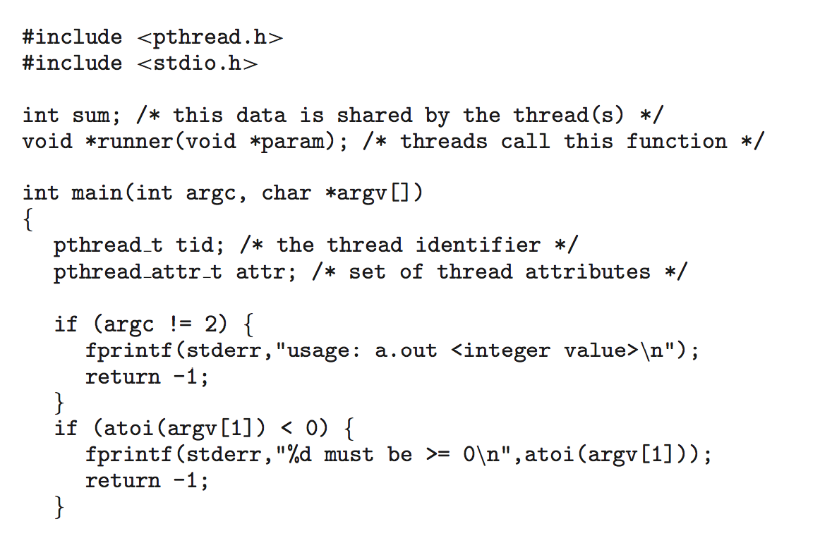
Pthreads Example

Slide 52
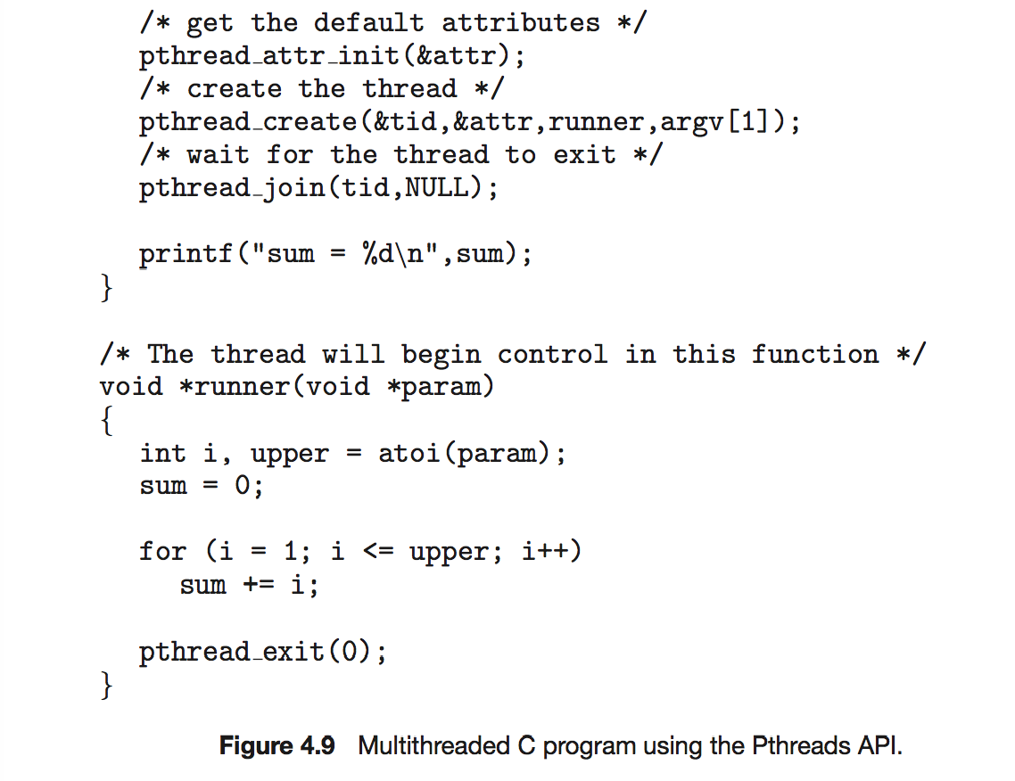
Pthreads Example (Cont.)

Slide 53
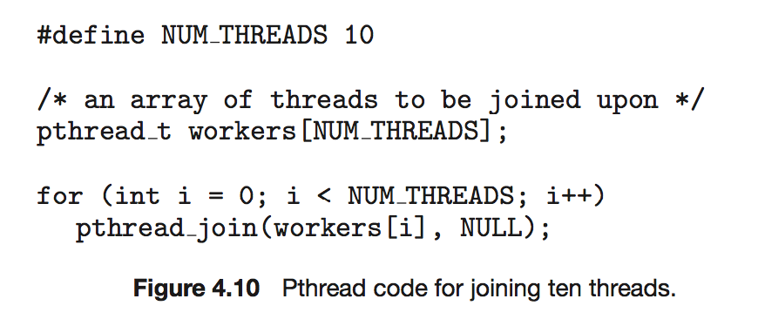
Pthreads Code for Joining 10 Threads

Slide 54
Implicit Threading
Growing in popularity as numbers of threads increase, program correctness more difficult with explicit threads
Creation and management of threads done by compilers and run-time libraries rather than programmers
Examples:
Thread Pools
OpenMP
Grand Central Dispatch
Microsoft Threading Building Blocks (TBB)

Slide 55
Thread Pools
Create a number of threads in a pool where they await work
Advantages:
Usually slightly faster to service a request with an existing thread than create a new thread
Allows the number of threads in the application(s) to be bound to the size of the pool
Separating task to be performed from mechanics of creating task allows different strategies for running task
i.e., tasks could be scheduled to run periodically
Windows API:
ThreadPool.QueueUserWorkItem(new WaitCallback(ThreadProc));
…
static void ThreadProc(Object stateinfo) {
…
}

Slide 56
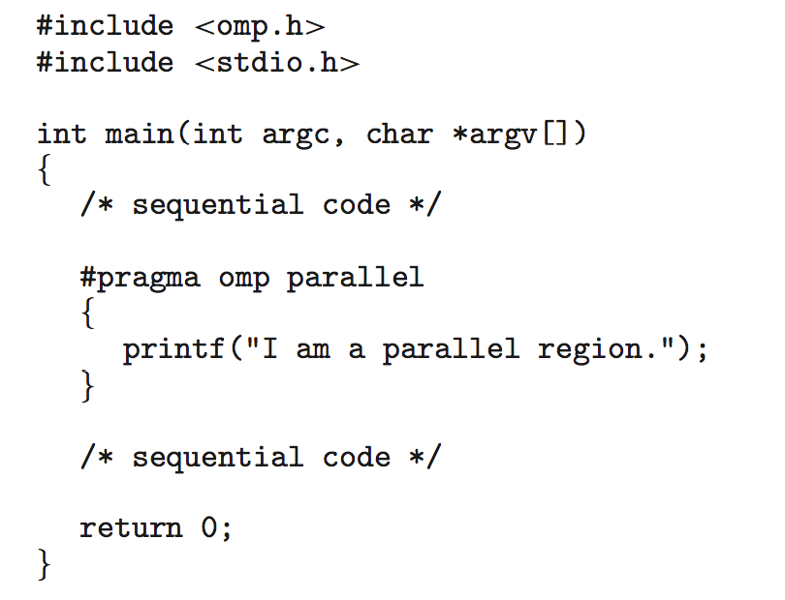
OpenMP
Set of compiler directives and an API for C, C++, FORTRAN
Provides support for parallel programming in shared-memory environments
Identifies parallel regions – blocks of code that can run in parallel
#pragma omp parallel
Create as many threads as there are cores
#pragma omp parallel for for(i=0;i<N;i++) {
c[i] = a[i] + b[i];
}
Run for loop in parallel

Slide 57
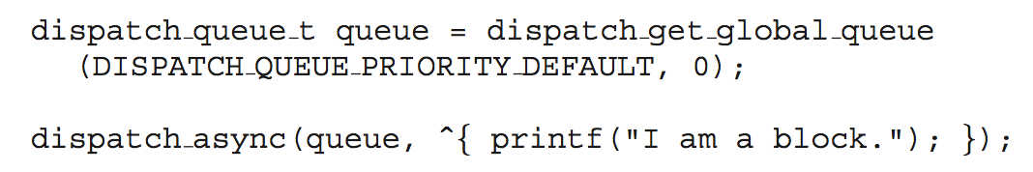
Grand Central Dispatch
Apple technology for Mac OS X and iOS operating systems
Extensions to C, C++ languages, API, and run-time library
Allows identification of parallel sections
Manages most of the details of threading
Block is in “^{ }” - ˆ{ printf("I am a block"); }
Blocks placed in dispatch queue
Assigned to available thread in thread pool when removed from queue
Two types of dispatch queues:
serial – blocks removed in FIFO order, queue is per process, called main queue
Programmers can create additional serial queues within program
concurrent – removed in FIFO order but several may be removed at a time
Three system wide queues with priorities low, default, high

Slide 58
Threading Issues: Semantics of fork() and exec()
Does fork()duplicate only the calling thread or all threads?
When is duplicating all threads a really bad idea?
Some OSes have two versions of fork
POSIX: only the calling thread
Exec()usually works as normal – replace the running process including all threads

Slide 59
Threading Issues: Signal Handling
Signals are used in UNIX systems to notify a process that a particular event has occurred.
A signal handler is used to process signals
Signal is generated by particular event
Signal is delivered to a process
Signal is handled by one of two signal handlers:
default
user-defined
Every signal has default handler that kernel runs when handling signal
User-defined signal handler can override default
For single-threaded, signal delivered to process

Slide 60
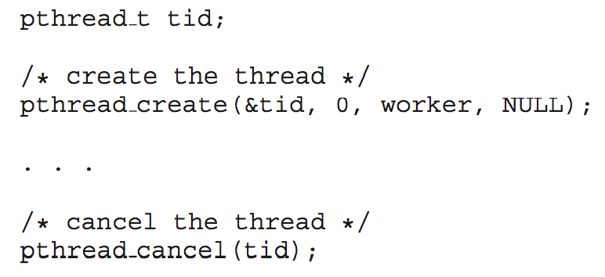
Threading Issues: Thread Cancellation
Terminating a thread before it has finished
Thread to be canceled is target thread
Two general approaches:
Asynchronous cancellation terminates the target thread immediately
Deferred cancellation allows the target thread to periodically check if it should be cancelled
Pthread code to create and cancel a thread:

Slide 61
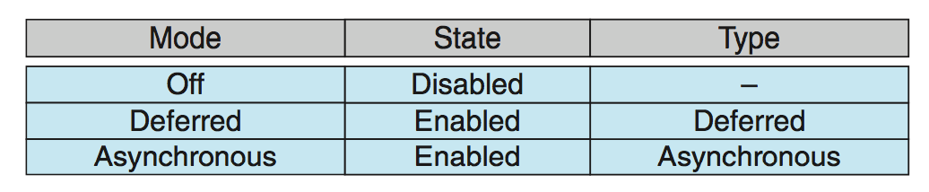
Thread Cancellation (Cont.)
Invoking thread cancellation requests cancellation, but actual cancellation depends on thread state
pthread_setcancelstate() -> enable/disable
Pthread_setcanceltype():
If thread has cancellation disabled, cancellation remains pending until thread enables it
Default type is deferred
Cancellation only occurs when thread reaches cancellation point
pthread_testcancel()
Asynchronous: terminate immediately

Slide 62
Thread-Local Storage
Thread-local storage (TLS) allows each thread to have its own copy of data
Useful when you do not have control over the thread creation process (i.e., when using a thread pool)
Different from local variables
Local variables visible only during single function invocation
TLS visible across function invocations
Similar to static data
TLS is unique to each thread

Slide 63
Linux Threads
Linux refers to them as tasks rather than threads
Thread creation is done through clone() system call
clone() allows a child task to share the address space of the parent task (process)
Flags control behavior

Slide 64
Thank You

